Slide 1
Final Presentation
Vivian Lin(vivianl5) Cheng Ai(chengai2) Haoyu Liu(haoyul11)

Slide 2
Project Outline
Introduction
Dataset Discussion
Dataset
Preliminary Analysis
Model Data Preprocessing
Feature Selection with k-Fold Cross-Validation
Best Model Discussion
Addition Analysis
Conclusion
Reference

Slide 3
Introduction
Motivation
Target users
Classifier Preference for Our Target Users
Primary Research Goal of Analysis: Prediction
Secondary Research Goal of Analysis: Interpretation + Descriptive Analytics

Slide 4
Motivation
Background
Predictive
Personal Experience
Challenge
Machine Learning Model

Slide 5
Target users
People who are planning to make a large purchase that relies on loan approval.
Financial and mortgage companies might also find this model useful for pre-assessing applications before detailed review.

Slide 6
Classifier Preference for Our Target Users
Borrowers making big purchases favor classifiers with high true‑positive approval rates, which bolster confidence and aid financial planning. On the other hand, for financial companies, they might emphasis more on accurately identifying rejections to reduce risk.

Slide 7
Primary Research Goal of Analysis
The primary research goal of this project is to build a predictive model that will effectively predict loan_status (approved or rejected) for the new dataset. To achieve our goal, we will use a logistic regression model that incorporates at least five explanatory variables, including both categorical and numerical features as listed in the following:
`loan_amnt`
`loan_intent`
`loan_int_rate`
`loan_percent_income`
`cb_person_cred_hist_length`
`credit_score`
`previous_loan_defaults_on_file`
`person_age`
`person_gender`
`person_education`
`person_income`
`person_emp_exp`
`person_home_ownership`

Slide 8
Secondary Research Goal of Analysis
Beside building an accurate classifier for loan approval, we will first utilize data visualization to discover some data insights. We will also identify most predictive and important features that indicates whether to lend money to the applicants or not.

Slide 9
Dataset Discussion
Source
Features

Slide 10
Source
The dataset used in this study comes from Kaggle (https://www.kaggle.com/datasets/taweilo/loan-approval-classification-data) and was created using computer techniques based on real patterns found in public datasets like the Credit Risk dataset on Kaggle. It shows information from 45000 loan applications, with each row represents one person's application information such as age, gender, education level, etc.
While the dataset covers many common loan situations, it doesn’t include every possible case, like people with unusual income sources or very complex financial histories. It is important to remember that though this dataset is useful for us to create a model; however, the results are not guaranteed.

Slide 11
Features
person_age: Age of the person.
person_gender: Gender of the person.
person_education: Highest education level.
person_income: Annual income.
person_emp_exp: Years of employment experience.
person_home_ownership: Home ownership status (e.g., rent, own, mortgage).
loan_amnt: Loan amount requested.
loan_intent: Purpose of the loan.
loan_int_rate: Loan interest rate.
loan_percent_income: Loan amount as a percentage of annual income.
cb_person_cred_hist_length: Length of credit history in years.
credit_score: Credit score of the person.
previous_loan_defaults_on_file: Indicator of previous loan defaults.
loan_status (target variable): Loan approval status: 1 = approved; 0 = rejected.

Slide 12
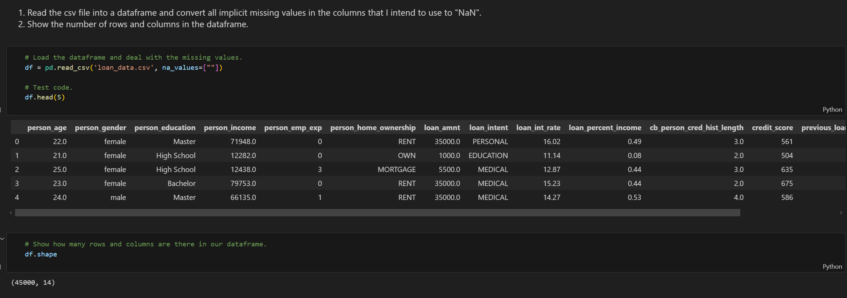
Load Dataset
1. Read the csv file into a dataframe and convert all implicit missing values in the columns that I intend to use to "NaN".
2. Show the number of rows and columns in the dataframe.
# Load the dataframe and deal with the missing values.
df = pd.read_csv('loan_data.csv', na_values=[" "])
# Test code.
df.head(5)
# Show how many rows and columns are there in our dataframe.
df.shape

Slide 13
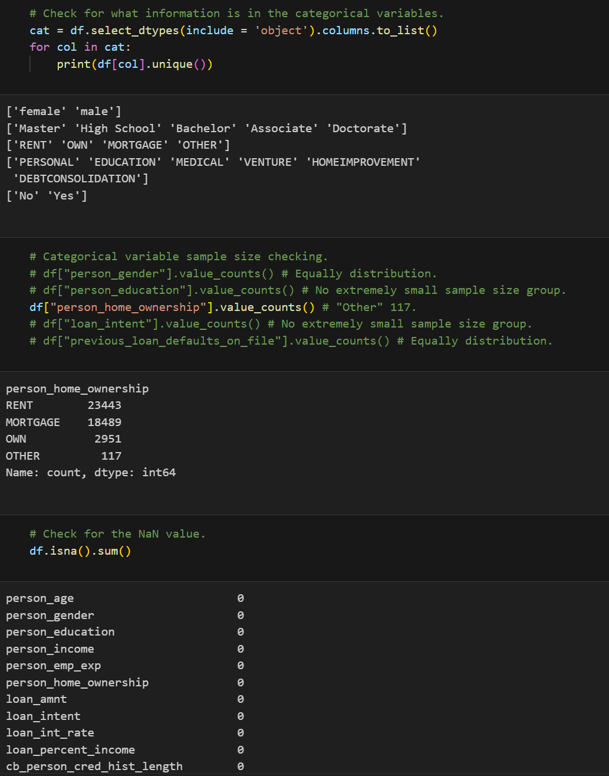
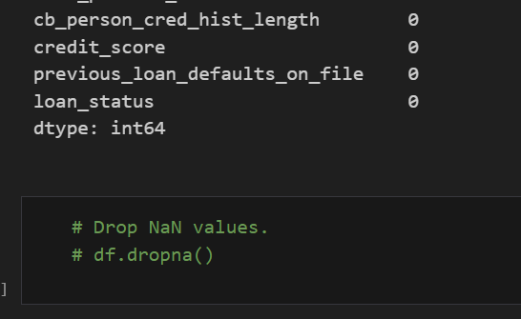
Dataset Cleaning
1. Check for NaN values
After checking the NaN value, we found out there is no implicit and explicit value in our dataset. So, for now we didn't drop any value.
Furthermore, we verified that no categorical variable contains levels with fewer than 30 observations.We confirmed that our dataset doesn't have the issue with categorical explanatory variable has some levels that only have a few observations.

Slide 14
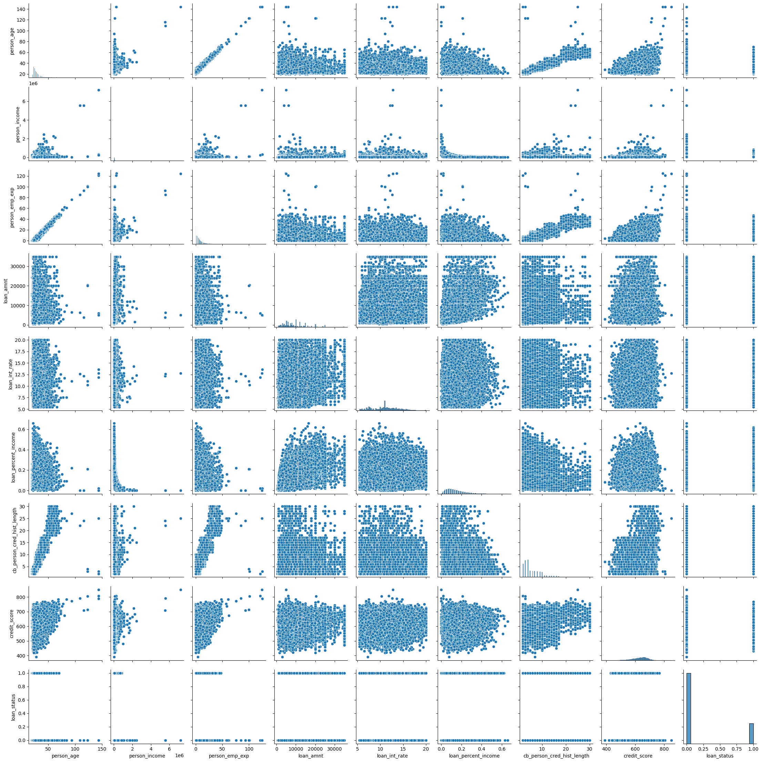
Dataset Cleaning
2. Outliers observation
The pair plot reveals outliers, but we’re postponing any removal until a systematic cleaning phase rather than relying on ad‑hoc eyeballing.
Outlier cleaning pros and cons evaluation
Removing those outliers could improve logistic‑regression accuracy for the broader, non‑outlier applicant population.
Keeping them preserves real‑world edge cases, ensuring the model reflects the full spectrum of applicants and their approval odds.
# Plot the pair plot to find out the outliers.
num_cols = df.select_dtypes(include = [np.number]).columns
sns.pairplot(df[num_cols])

Slide 15
Dataset Cleaning
The dataset used in this study comes from Kaggle (https://www.kaggle.com/datasets/taweilo/loan-approval-classification-data) and was created using computer techniques based on real patterns found in public datasets like the Credit Risk dataset on Kaggle. It shows information from 45000 loan applications, with each row represents one person's application information such as age, gender, education level, etc.
While the dataset covers many common loan situations, it doesn’t include every possible case, like people with unusual income sources or very complex financial histories. It is important to remember that though this dataset is useful for us to create a model; however, the results are not guaranteed.

Slide 16
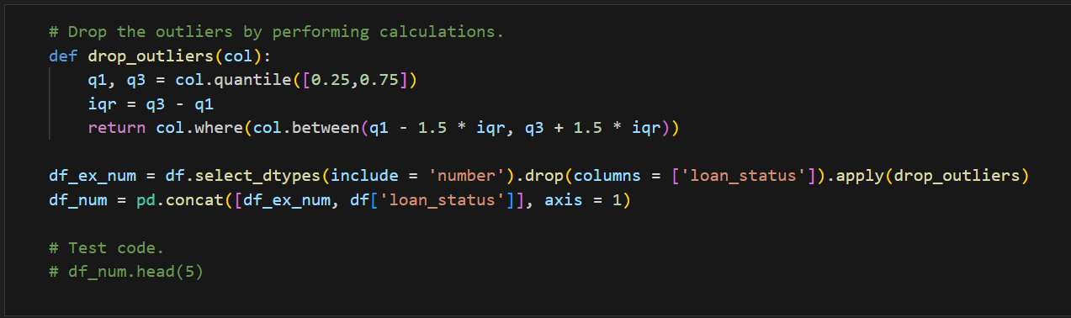
Dataset Cleaning
3. Other data cleaning: Whole dataset outliers dropping
To perfom a more rigorous data cleaning, we drop the data points that are outside the lower bound and upper bound as below.

Slide 17
Final Dataset
Combine the categoriacl part with the numerical part of our dataset back together after dropping the outliers:
# Categoriacl part of our dataset.
df_cat = df.select_dtypes(include = 'object')
# Test code.
# df_cat.head(5)
# Combine the categoriacl part with the numerical part of our dataset back together after dropping the outliers.
df_final = pd.concat([df_cat, df_num], axis = 1)
# Test code.
# df_final.head(5)

Slide 18
Final Dataset
Drop the outliers and show how many rows that we dropped:
# Drop the outliers.
df_final = df_final.dropna().reset_index(drop = True)
# Test code.
# df_final.head(5)
# Calculation of how many rows that we dropped.
len(df) - len(df_final)

Slide 19
Preliminary Analysis
Categorical Variable Relationships with Loan Status
Numerical Variable Relationships with Loan Status
Multicollinearlty Asscessment
Finding Interactions between Categorical and Numerical Explanatory Variable Pairs

Slide 20
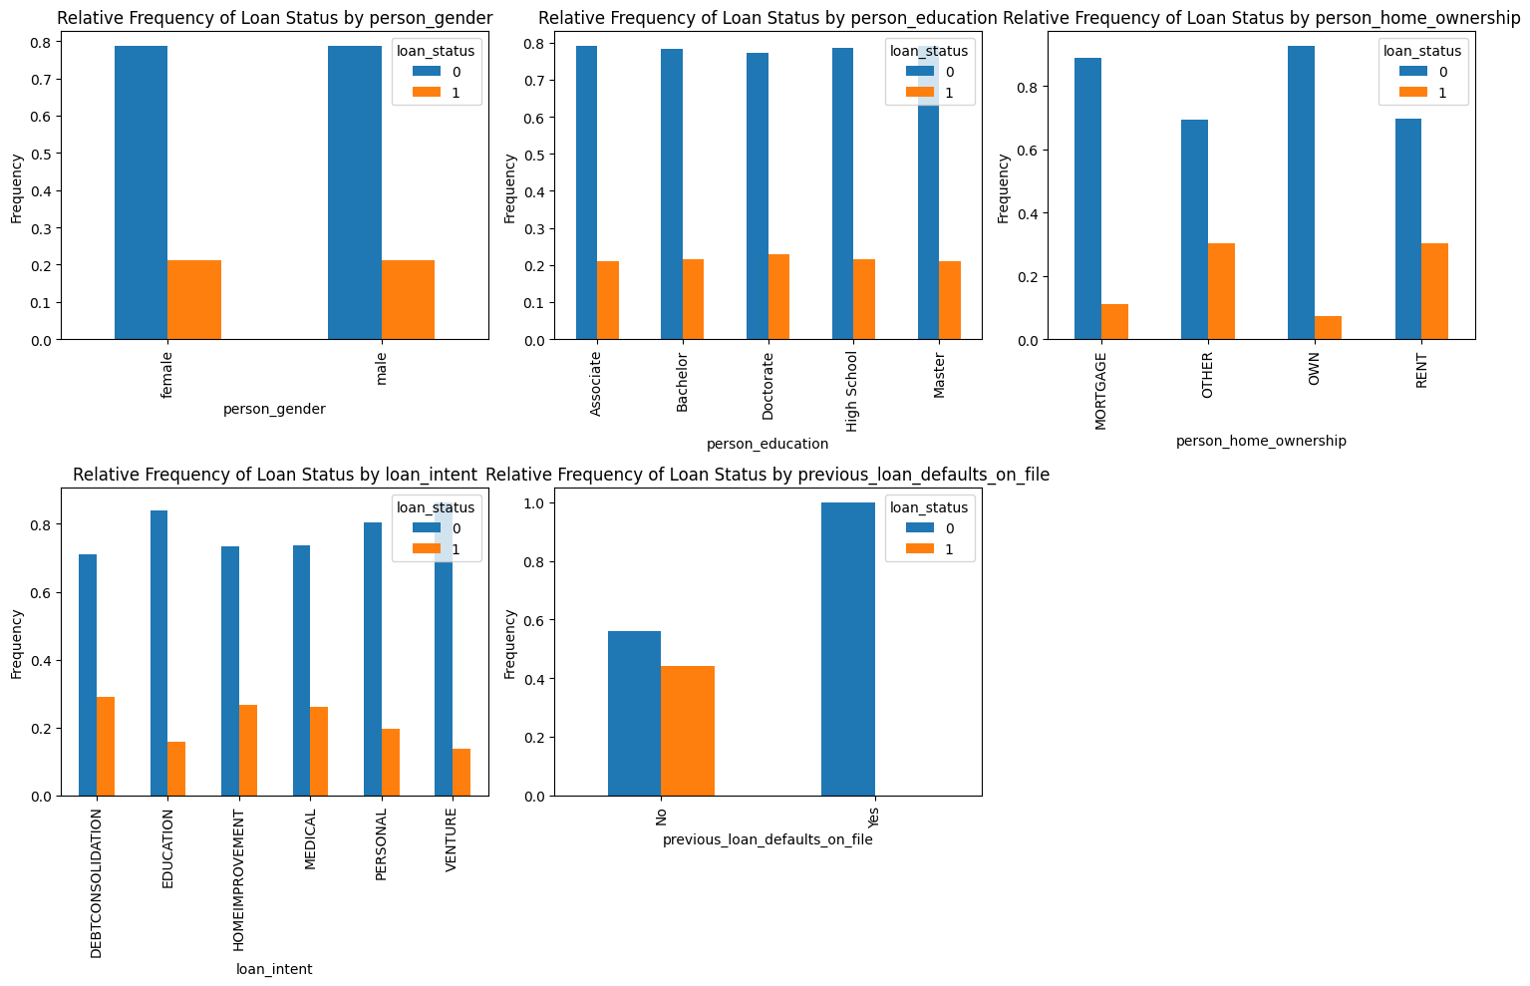
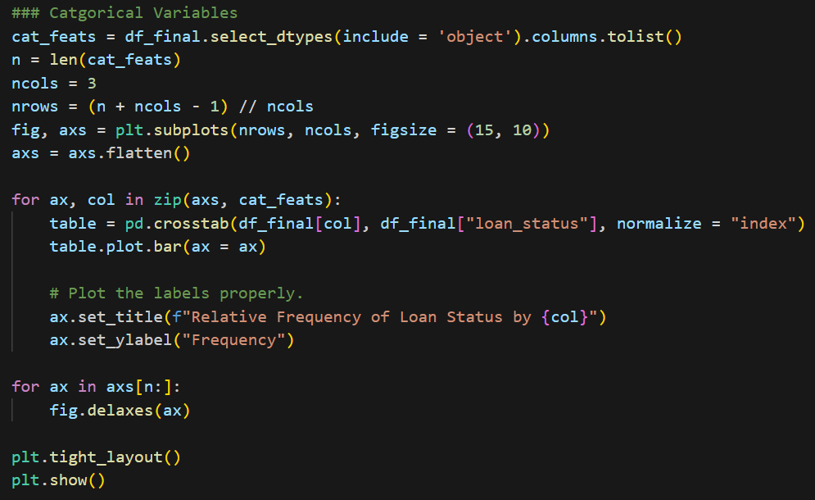
Preliminary Analysis
1. Categorical Variable Relationships with Loan Status
Including every categorical predictor in the approval‑probability logistic model is computationally impractical, so we first discard those with minimal standalone power; for instance, “person_gender” and “person_education” show almost no difference in approval‑status distributions and add little value.

Slide 21
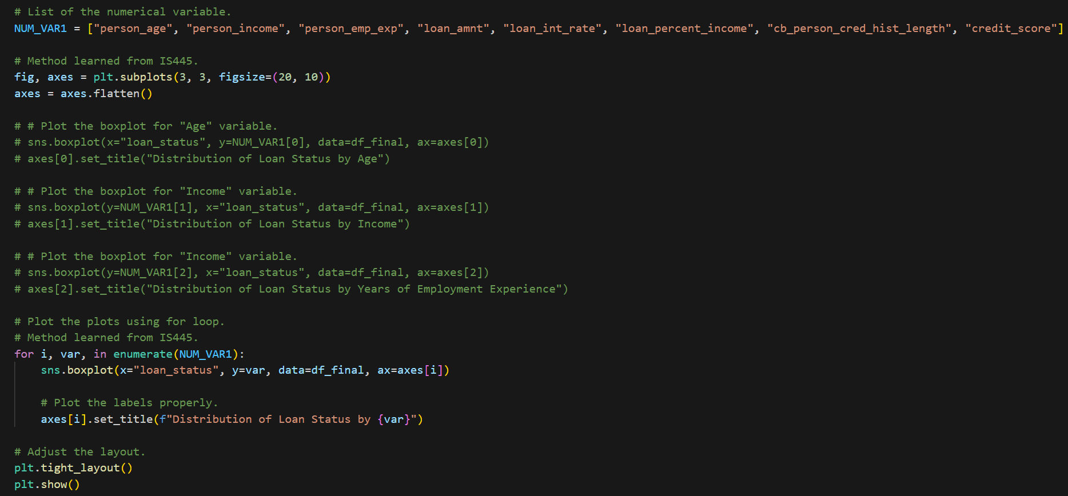
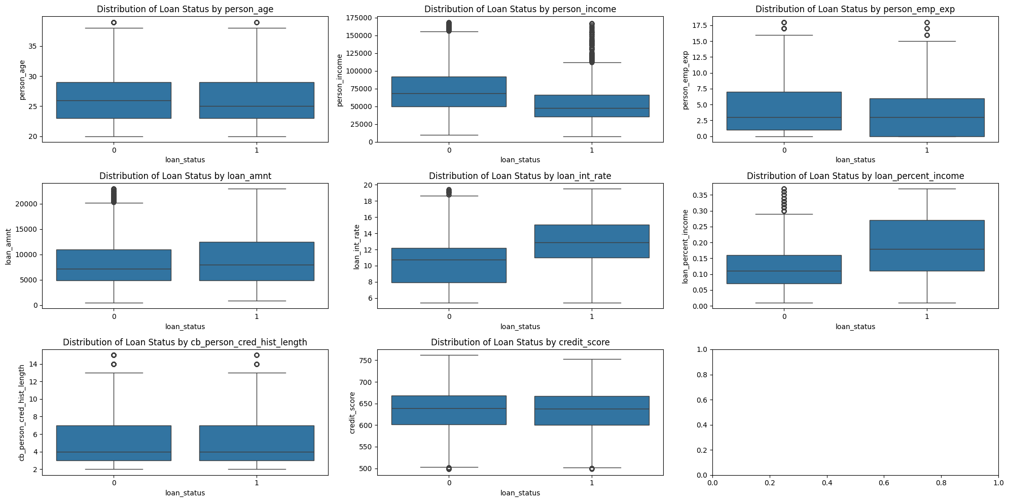
Preliminary Analysis
2. Numerical Variable Relationships with Loan Status
To keep the logistic model tractable, we first drop numerical predictors with weak standalone power. Box plots reveal clear associations between loan_status and person_income, loan_int_rate, and loan_percent_income, so these three variables will be retained.

Slide 22
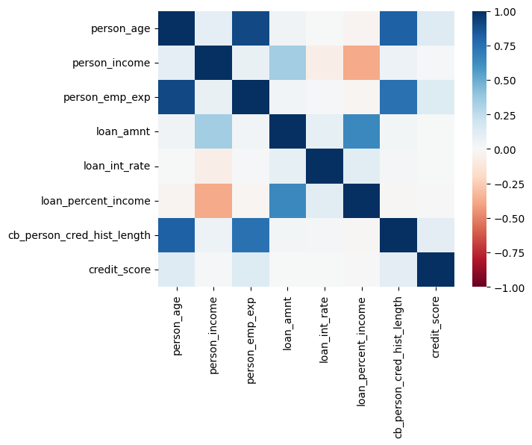
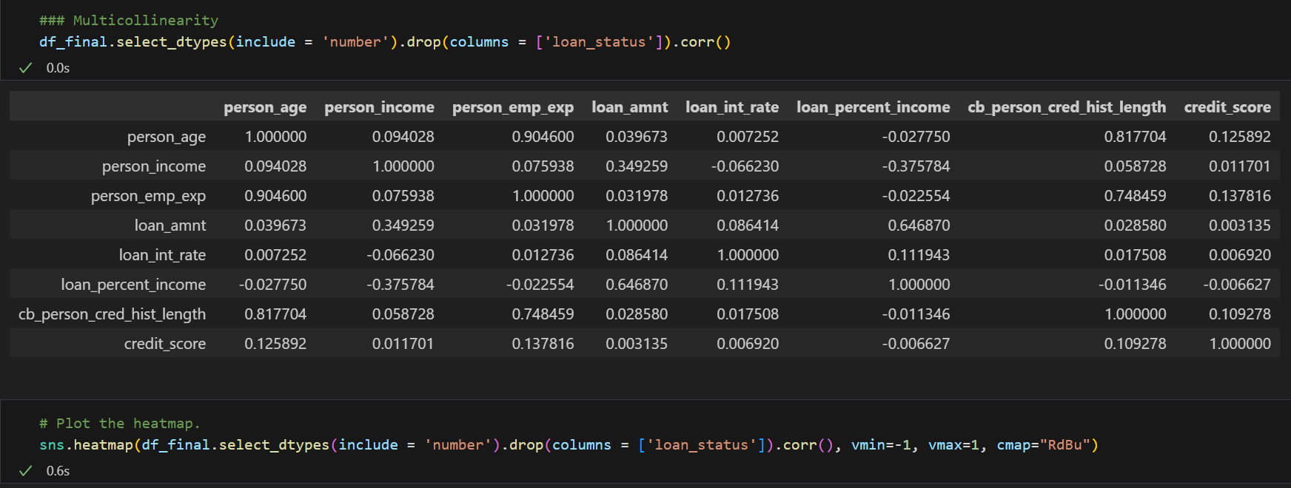
Preliminary Analysis
3. Multicollinearlty Asscessment
Is there an association between the numerical variables pairs in this dataset? Yes, since we can see at least one pair of explanatory variables pair will have value greater than the threshold(0.7).

Slide 23
Preliminary Analysis
4. Finding Interactions between Categorical and Numerical Explanatory Variable Pairs
We examined all categorical‑numerical feature pairs for their influence on loan_status. The plots show the weakest interactions for (person_age, person_gender) and (person_age, previous_loan_defaults_on_file), evidenced by nearly parallel slopes. Generating all 40 plots would be slow and clutter the notebook, so we present only a representative subset.

Slide 24
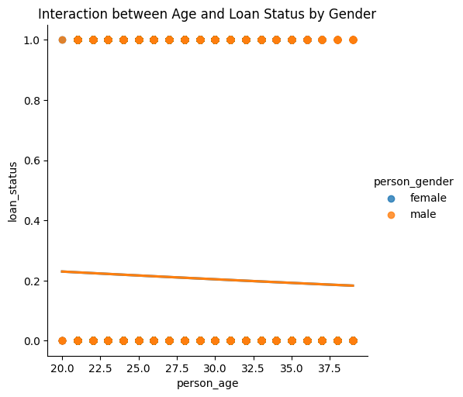
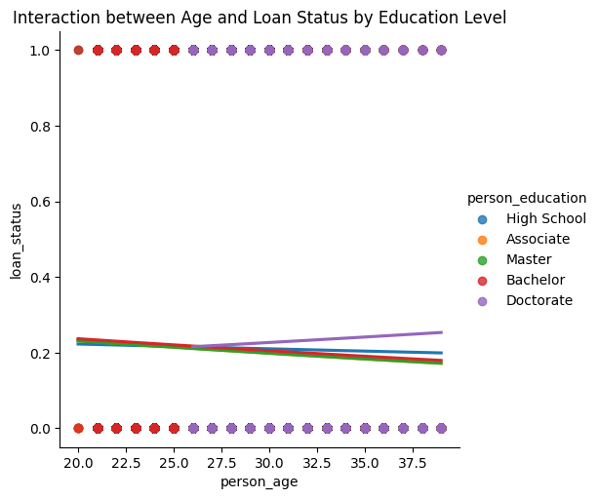
Plot 1 & 2
# Plot 1
sns.lmplot(x="person_age", y="loan_status", hue="person_gender", data=df_final, logistic=True, ci=False)
# Plot the label properly
plt.title("Interaction between Age and Loan Status by Gender")
plt.show()
# Plot 2
sns.lmplot(x="person_age", y="loan_status", hue="person_education", data=df_final, logistic=True, ci=False)
# Plot the label properly
plt.title("Interaction between Age and Loan Status by Education Level")
plt.show()

Slide 25
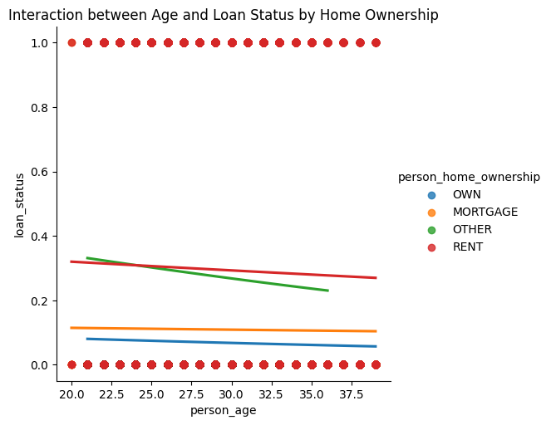
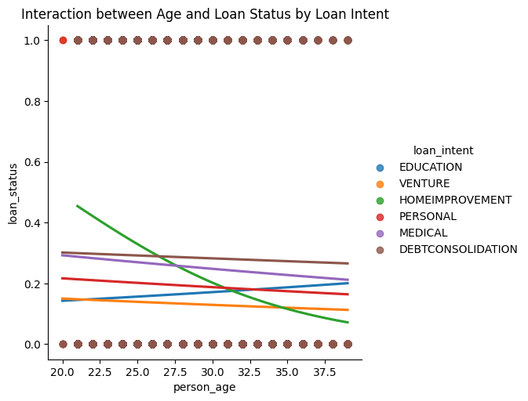
Plot 3 & 4
# Plot 3
sns.lmplot(x="person_age", y="loan_status", hue="person_home_ownership", data=df_final, logistic=True, ci=False)
# Plot the label properly
plt.title("Interaction between Age and Loan Status by Home Ownership")
plt.show()
# Plot 4
sns.lmplot(x="person_age", y="loan_status", hue="loan_intent", data=df_final, logistic=True, ci=False)
# Plot the label properly
plt.title("Interaction between Age and Loan Status by Loan Intent")
plt.show()

Slide 26
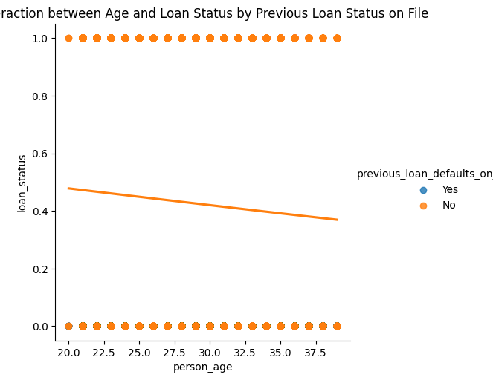
Plot 5
# Plot 5
sns.lmplot(x="person_age", y="loan_status", hue="previous_loan_defaults_on_file", data=df_final, logistic=True, ci=False)
# Plot the label properly
plt.title("Interaction between Age and Loan Status by Previous Loan Status on File")
plt.show()

Slide 27
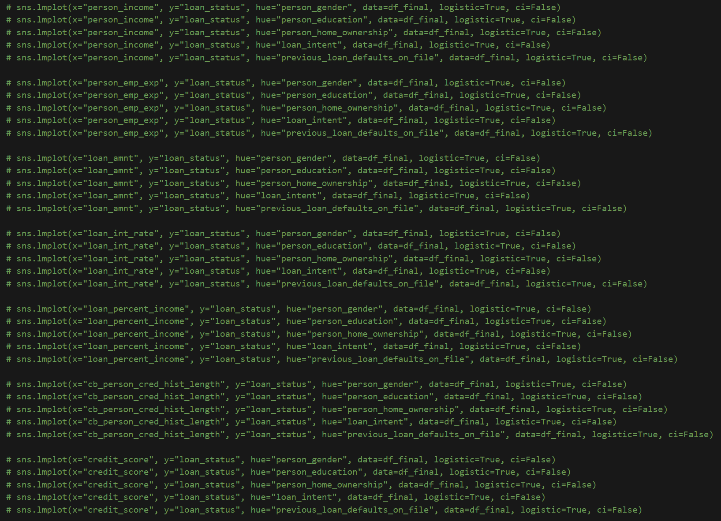
The Rest of the Plots

Slide 28
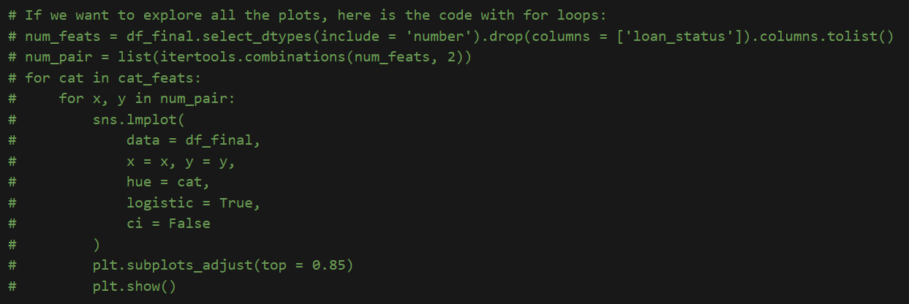
The Rest of the Plots

Slide 29
Model Data Preprocessing
# Check the form of our response variable
df_final["loan_status"]
# Create the feature matrix and target array
df_feature = df_final.drop(columns = ['loan_status'], axis = 1)
df_target = df_final['loan_status']
# Test code.
# df_feature
# df_target
# Scaling
scaler = StandardScaler()
num_vars = df_feature.select_dtypes(include = 'number').columns
df_feature[num_vars] = scaler.fit_transform(df_feature[num_vars])
# Test code
# df_feature.head(5)
# df_feature[num_vars].std()
# Convert the indicator variable to the correct form.
df_feature = pd.get_dummies(df_feature, drop_first = True) * 1
# Test code.
# df_feature.head(5)

Slide 30
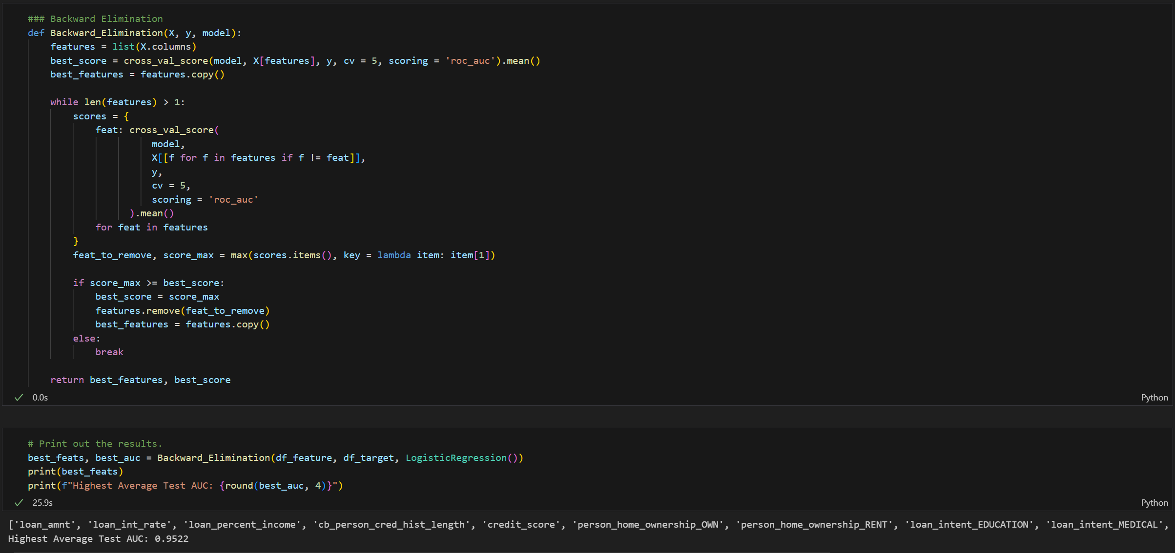
Feature Selection with k-Fold Cross-Validation
To gauge performance on unseen data, we’ll run backward elimination and select the logistic‑regression model with the highest average test AUC from 5‑fold cross‑validation.

Slide 31
Best Model Discussion
Best Model Equation
Test Dataset ROC Curve
Multicollinearity Asscessment
Overfitting Asscessment
Best Predictive Probability Threshold

Slide 32
Best Model Equation
Backward-elimination with 5-fold crossvalidation identified the top model, AUC = 0.9522, built on eight predictors: loan_amnt, loan_int_rate, loan_percent_income, cb_person_cred_hist_length, credit_score, person_home_ownership, loan_intent, and previous_loan_defaults_on_file. Interaction terms were omitted to avoid overfitting and bias from test-set-driven selection. Because the data were standardized, coefficient magnitudes directly reflect variable importance, with previous_loan_defaults_on_file_Yes emerging as the most influential feature.

Slide 33
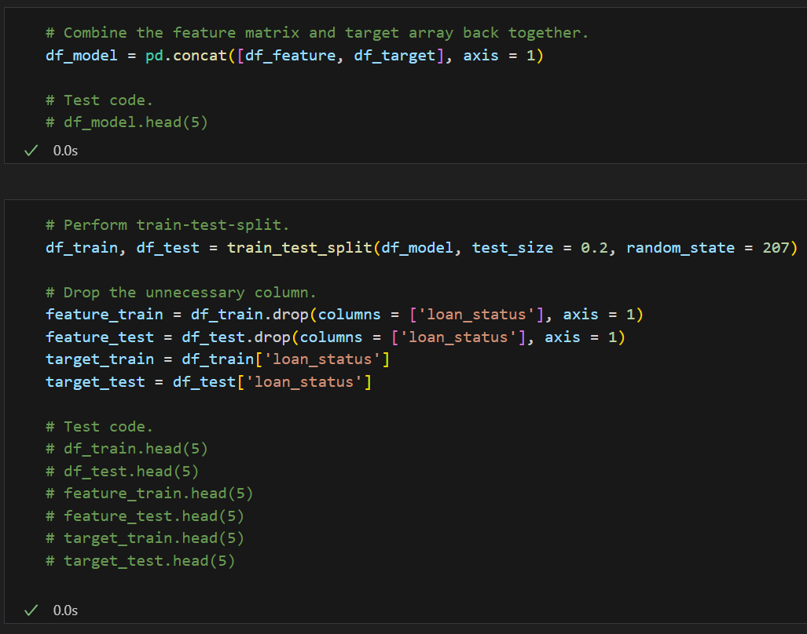
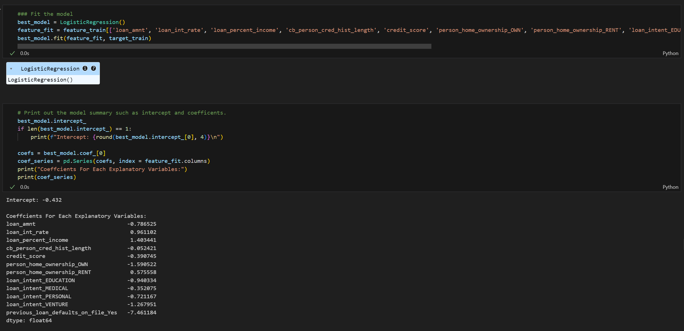
Best Model Equation

Slide 34
Test Dataset ROC Curve
Now, we are going to create an ROC curve for this logistic regression model and the test dataset, and also calculate the AUC of this ROC curve.
By achieving the 0.8317 AUC value, we assume that our best model perform quite well since it is close to the ideal scenario AUC(1).

Slide 35
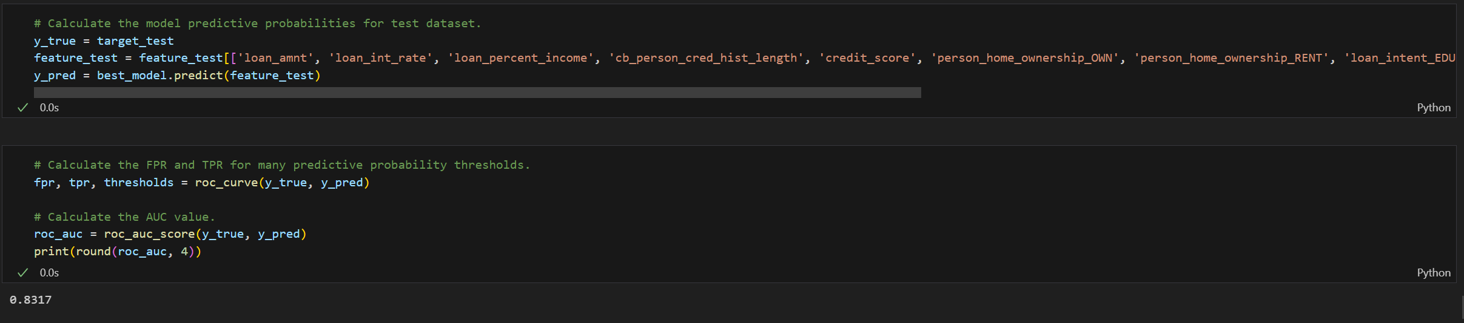
Test Dataset ROC Curve

Slide 36
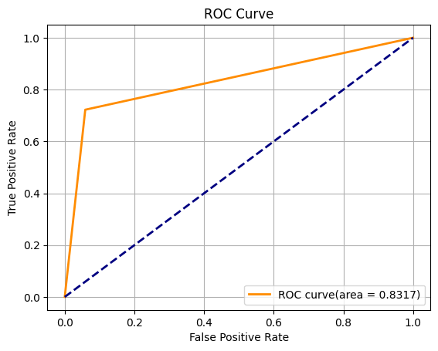
Test Dataset ROC Curve
# Plot the ROC curve.
def plot_roc(fpr, tpr, auc, lw=2):
plt.plot(fpr, tpr, color="darkorange", lw=lw, label="ROC curve(area = " + str(round(roc_auc, 4)) + ")")
plt.plot([0, 1], [0, 1], color="navy", lw=lw, linestyle="--")
plt.title("ROC Curve")
plt.xlabel("False Positive Rate")
plt.ylabel("True Positive Rate")
plt.legend(loc="lower right")
plt.grid(True)
plt.show()
# Display the plot.
plot_roc(fpr, tpr, roc_auc)

Slide 37
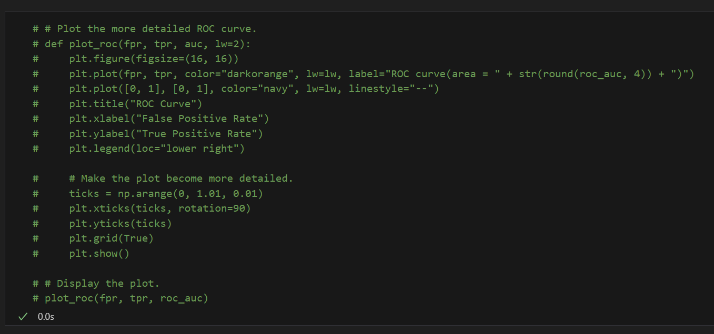
Test Dataset ROC Curve

Slide 38
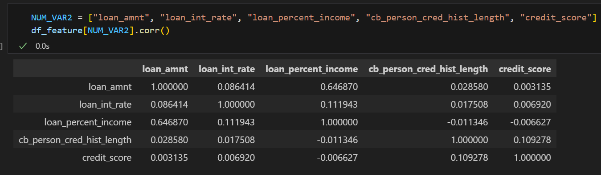
Multicollinearity Asscessment
Do the remaining explanatory variables in our model exhibit an issue with multicollinearity?
No, since we don't see any explanatory variables pair that have correlation value greater than the threshold(0.7).

Slide 39
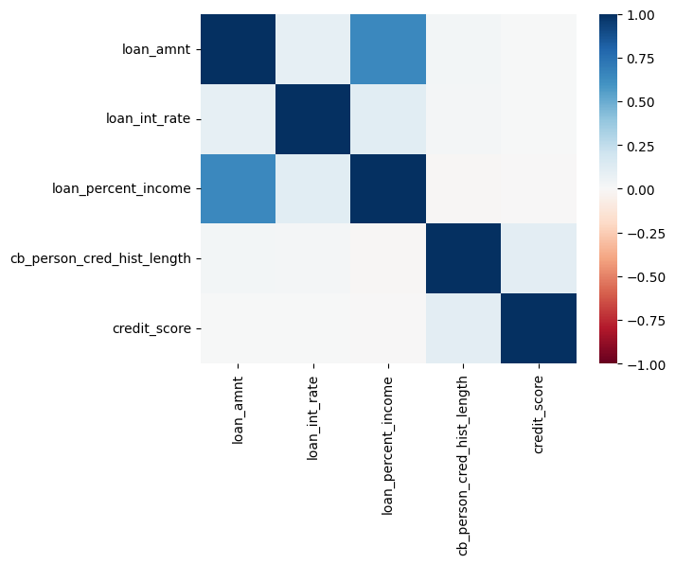
Multicollinearity Asscessment
# Plot the heatmap.
sns.heatmap(df_feature[NUM_VAR2].corr(), vmin=-1, vmax=1, cmap="RdBu")

Slide 40
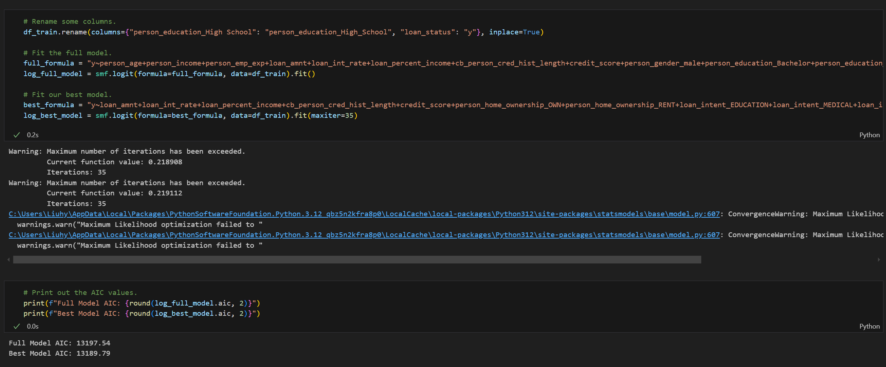
Overfitting Asscessment
Does the fact that this is our "best model" suggest that some of our explanatory variables were overfitting the model?
We don't think some of our explanatory variables would result in our best model overfitting. This is because our best model is more parsimonious due to its lower AIC value.

Slide 41
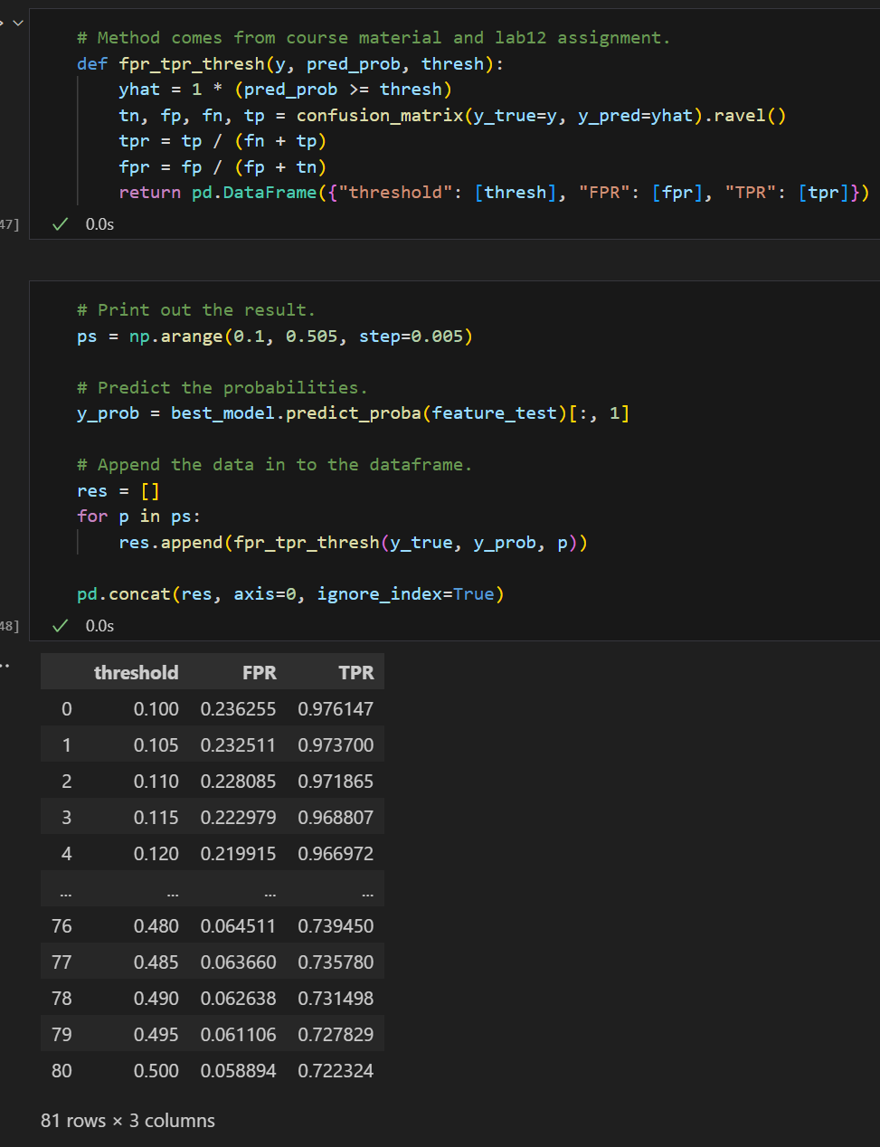
Best Predictive Probability Threshold
The ROC curve’s closest point to the ideal (TPR = 1, FPR = 0) is (TPR = 0.72, FPR = 0.06), corresponding to a threshold of 0.495—high recall with acceptably low false alarms. Lowering the threshold would boost TPR but also raise FPR, so the trade‑off merits careful consideration.

Slide 42
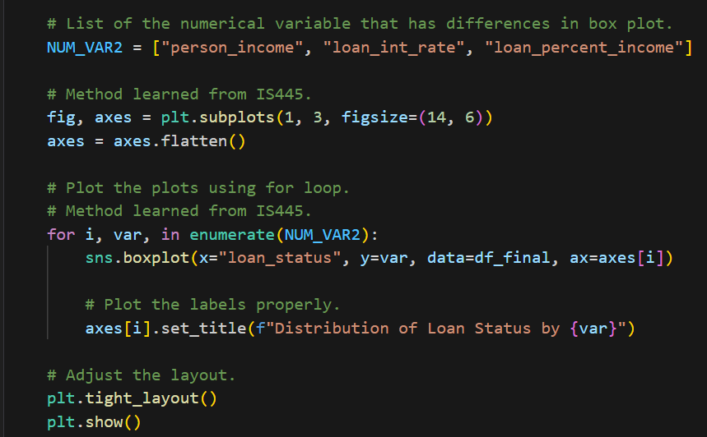
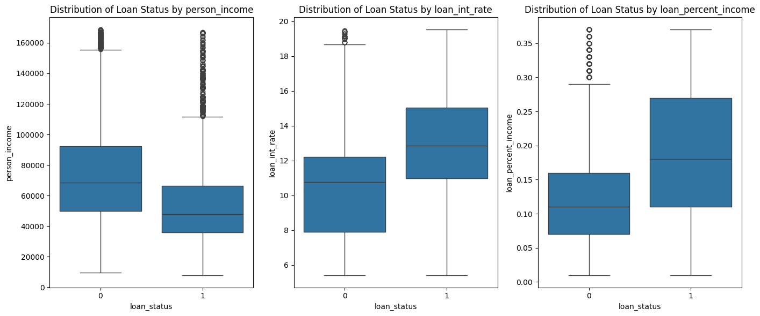
Additional Analysis/Insight
T-tests on person_income, loan_int_rate, and loan_percent_income confirmed significant differences between approved and rejected applicants, as suggested by the boxplots. Yet not all three appear in the final model—interactions or multicollinearity likely dilute their combined predictive value.

Slide 43
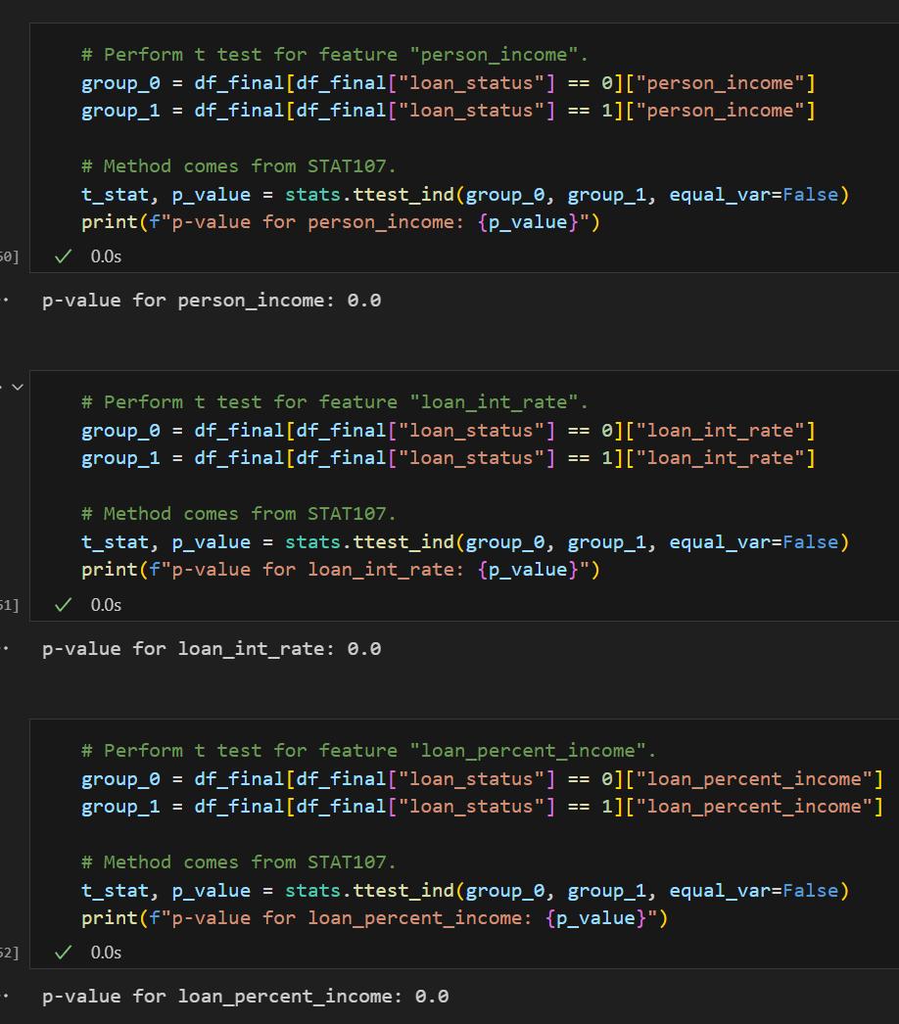
Additional Analysis/Insight

Slide 44
Conclusion
9.1 Recommendation
We would recommend users to use our model as a pre-screening simulator for the loan application approval. We have a AUC of 0.8317, which indicates the robustness of our model.
9.2 Shortcomings
The limitation of this model would be
(1) The age range of the applicants is mostly between 20 to 30 years old, so the model might not be predictive if the user's age does not fall into this range.
(2) The size of the training data could be expanded to ensure a more robust prediction.
9.3 Future Work
Based on the above shortcomings, the future steps would be:
(1) collect more data to make the model more robust
(2) try out other models(such as decision tree, support vector machine, and neural network) besides logistice regression to improve the classification performance.

Slide 45
Reference
Kim, H., & DeVaney, S. A. (2020, January 31). The determinants of outstanding balances among credit card revolvers. AFCPE. https://www.afcpe.org/news-and-publications/journal-of-financial-counseling-and-planning/volume-12-1/the-determinants-of-outstanding-balances-among-credit-card-revolvers/
Ibm. (2025a, April 16). What is Artificial Intelligence in Finance?. IBM. https://www.ibm.com/think/topics/artificial-intelligence-finance

Slide 46
Thank You!

